Slide 1
Chap 02: Java Programming Environment
Core Java, Volume I

Slide 2
Installing Java
Download the Java Software Development Kit (JDK) from http://www.oracle.com/technetwork/java/javase/downloads.
Navigating the Oracle site requires mastery of some Java jargon.
Also download and unzip the documentation of the application programming interface (API).
Install the JDK, using the provided installer.
Set the PATH environment variable.
Download the sample code for these lessons.
Install an integrated development environment (IDE) such as Eclipse, NetBeans, or IntelliJ.

Slide 3
Java Jargon
Java Development Kit | JDK | The software for programmers who want to write Java programs
Java Runtime Environment | JRE | The software for consumers who want to run Java programs
Standard Edition | SE | The Java platform for use on desktops and simple server applications
Enterprise Edition | EE | The Java platform for complex server applications
Micro Edition | ME | The Java platform for use on cell phones and other small devices
Update | u | Oracle’s term for a bug fix release
NetBeans | — | Oracle’s integrated development environment

Slide 4
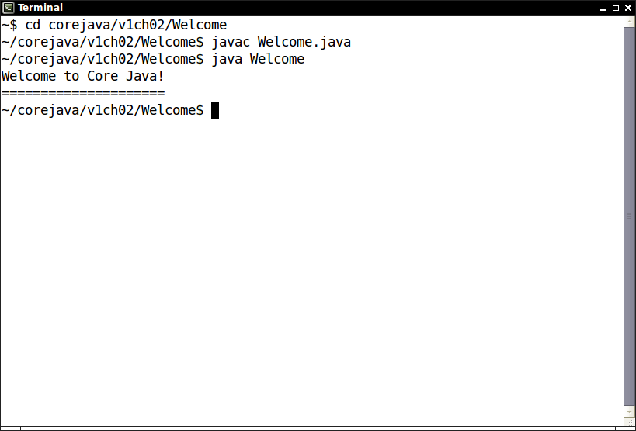
Using the Command-Line Tools
Open a terminal window.
Change to the directory where you unzipped the sample code for these lessons.
Run the following commands
Cd corejava/v1ch02/Welcome
Javac Welcome.java
Java Welcom
Congratulations! You have just compiled and run your first Java program.

Slide 5
Using the Command-Line Tools
Welcome.java
// This program displays a greeting for the reader.
public class Welcome
{
public static void main(String[] args)
{
String greeting = "Welcome to Core Java!";
System.out.println(greeting);
for (int i = 0; i < greeting.length(); i++)
System.out.print("=");
System.out.println();
}
}

Slide 6
Using an Integrated Development Environment
It is useful to know how to compile programs from the command line.
For day-to-day work, integrated development environments are more convenient.
Excellent choices are the freely available Eclipse, NetBeans, and IntelliJ IDEA.
Eclipse will be used in this lecture
Download from http://eclipse.org.
Unzip, then launch Eclipse.
Select File → New → Project from the menu.
Make a Java project with existing sources
at corejava/v1ch02/Welcome.
Run the program.
Introduce an error: Change String to string
Note the error in the Problems pane.
Note the wiggly underline.

Slide 7
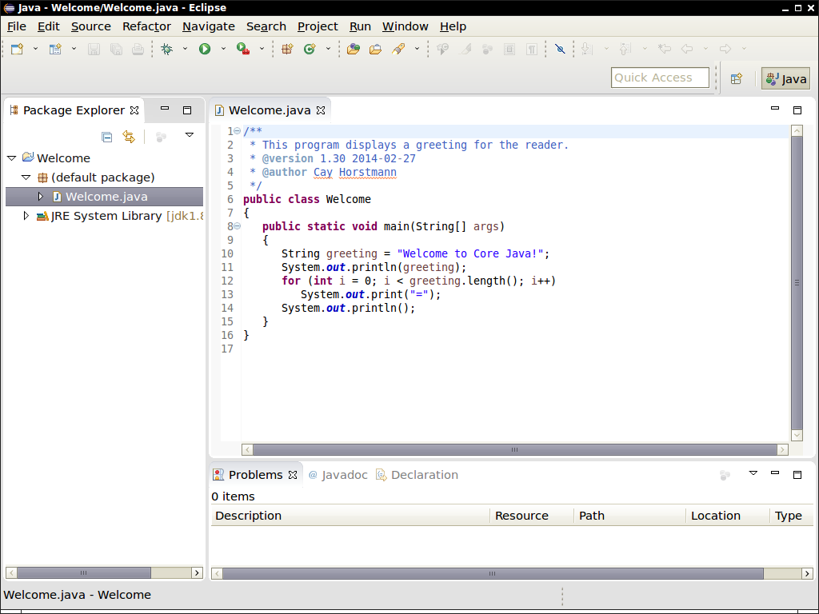
Using an Integrated Development Environment
.

